Slide 1
Flash — AI-Powered Email and Calendar Agent
BCS685 - Project Phase I
Review - 2
Submitted By
1CR23CS149 – Ronish Rohan
1CR23CS107 – MD Nihal Rahman
Guidance of
Prof. Ann Mathews, Associate Professor
Date:01/04/26

Slide 2
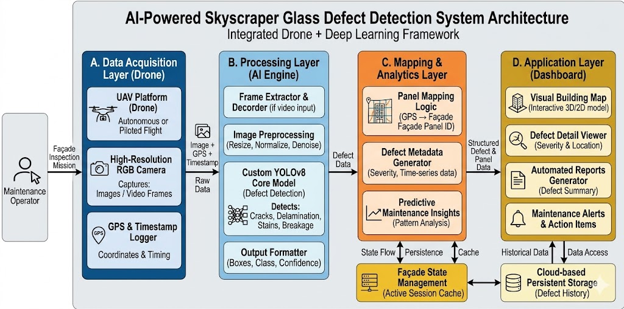
System Architecture

Slide 3
Flow of Diagram
1. User Input:
Natural language command via chat
E.g. "Archive all newsletters from this week"
Model and effort level selection (Flash/Pro, Low/Med/High)
2. Chat API Route:
POST /api/chat receives message array
Validates request body (messages, model, effort)
Returns 400/401 for invalid/unauth requests
Initiates streaming ReadableStream response
3. Auth & Token Retrieval:
Authenticate user via Supabase server client
Retrieve Gmail OAuth tokens from gmail_tokens table
Output: User ID + valid access token
4. Agent Initialisation (Core Logic - Stage 1):
Auto-refresh expired access tokens (5-min buffer)
Load 16 Gmail + Calendar tool schemas
Convert chat history to Pi AI SDK format
Set system prompt + reasoning effort level
Output: Configured agent ready for loop
5. Agentic Loop (Core Logic - Stage 2):
LLM receives messages + 16 tool schemas
Model reasons and selects tools to invoke
Execute tool calls against Gmail/Calendar API
Append tool results to conversation history
Continue loop (max 8 turns)
Output: Streamed text response + completed actions
6. Response Streaming & Persistence:
Stream text deltas token-by-token to frontend
Save assistant message to Supabase
Generate conversation title via LLM
Output: Complete response + persisted history
7. Conversation Management:
Create/list/fetch conversations via API
Store messages with role + content
Auto-generate titles from first message
Output: Persistent chat history
8. Database Layer (Supabase)
Tables: gmail_tokens, conversations, messages
PostgreSQL with Row-Level Security (RLS)
Auto-updated timestamps via triggers
User data isolation via auth.uid() policies
9. Frontend UI Layer
Chat interface with StreamingText component
ReactMarkdown for formatted responses
Collapsible sidebar with conversation list
Model picker (Flash/Pro) + effort selector
10. Gmail & Calendar Tool Execution
16 tools: list, get, search, send, reply, archive, trash, label, draft emails + calendar CRUD
Direct REST API calls with OAuth bearer tokens
11. Loop Termination & Output
Stop when model produces text-only response
Or after max 8 turns (bounded execution)
Final response streamed and persisted
User Message/API Route → Auth & Tokens → Agent Init → Agentic Loop → Streaming → Persist & Display

Slide 4
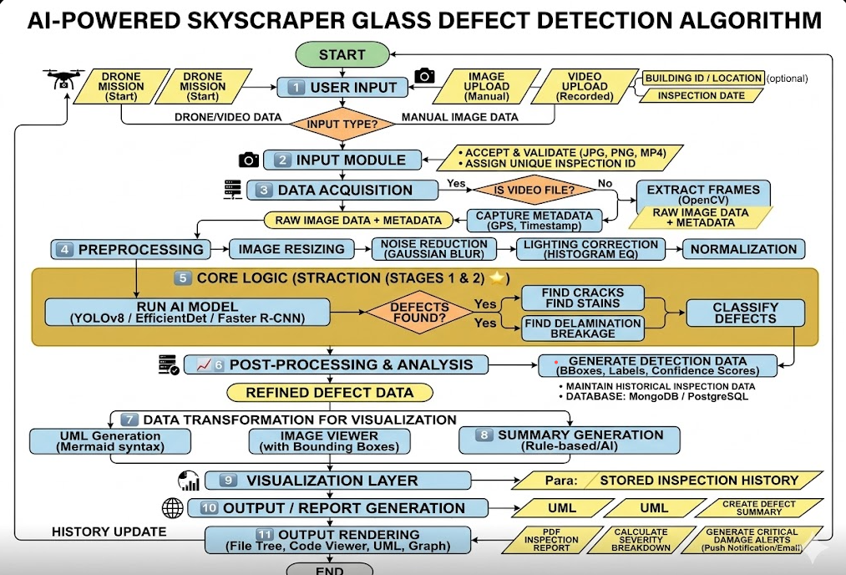
Agentic Loop Architecture

Slide 5
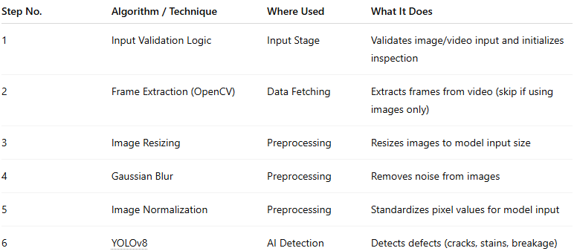
Tools & Technologies

Slide 6
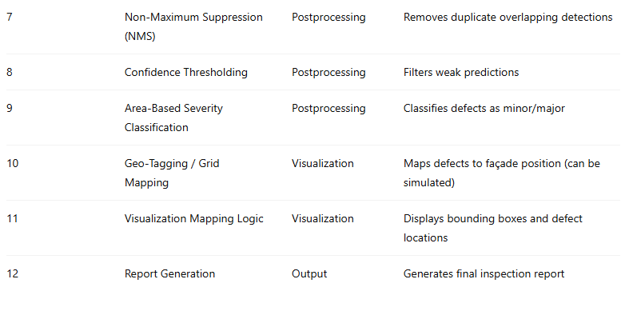
Tools & Technologies

